Slide 1
Learning Fair Representation (LFR) vs Maximizing Fairness Under Accuracy Constraints (gamma and Fine-gamma)
Group 2: Samira Kamal, Shuangxian Li, Weijia Wang, Yudan Zhang, Zeya Ahmad

Slide 2
Dataset
Compas-scores-two-years.csv
There are 7214 rows & 53 columns in the initial dataset. After editing, there are 6129 rows & 25 columns used for the implement of LFR.
Interested variable: races (African-American & Caucasian)
Notes:
Before we built our models, defandants with African-American race were regarded as non-sensitive/unprotected group,and Caucasian defandants are regarded as sensitive/protected group.

Slide 3






Model1:(A1) Learning Fair Representations
Initial Clean & Edit:
Under the LFR algorithm, we transferred some categorical variables ('sex', 'race', 'c_charge_degree', 'age_cat', 'v_score_text', 'score_text') to dummy variables and splitted dataset based on variable race (Caucasian and African-American) into sensitive group and nonsensitive group. Then split the processed dataset into 3 parts: 60% training, 20% validation and 20% testing set.

Slide 4
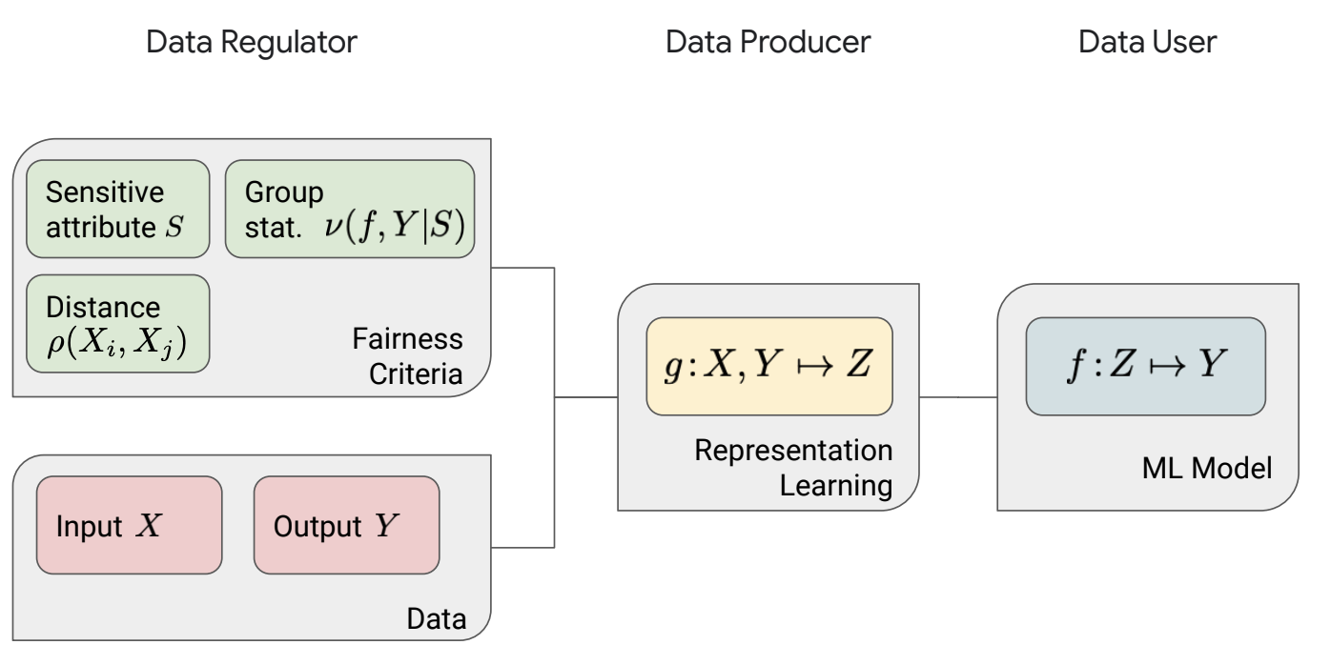
Model1:(A1) Learning Fair Representations cont.
Basic Logic Structure Image for LFR

Slide 5
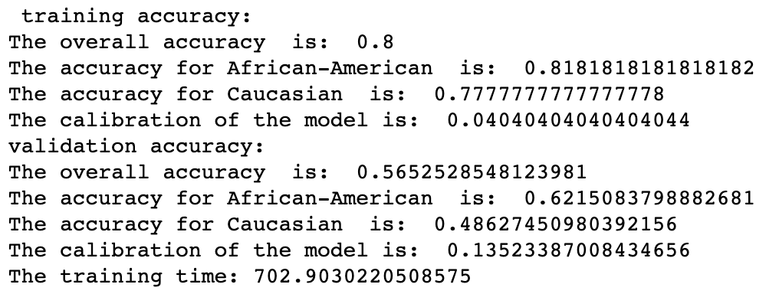
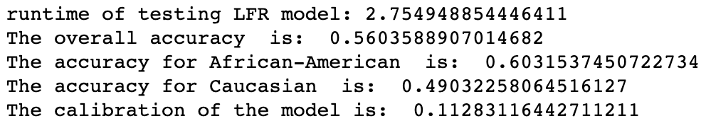
Model1:(A1) Learning Fair Representations cont.
Result:
Testing:

Slide 6
Model1:(A1) Learning Fair Representations cont.
Result:
Testing:

Slide 7
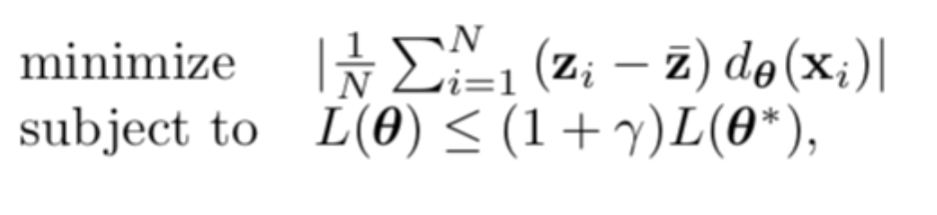
Model2: (A3)Maximizing Fairness Under Accuracy Constraints
Found the decision boundary parameters by minimizing the corresponding absolute decision boundary covariance over the training set under constraints on the classifier laws function.
Optimal loss over the training set by unconstrained classifier

Slide 8
Model2: (A3)Maximizing Fairness Under Accuracy Constraints
Race is removed from feature set and reduced to Caucasian and African-American
We use race as protected attribute, where race is Caucasian are the protected group and race is African-American are the non-protected group.
p%-rule - a way to quantify disparate impact
# determine p% ratio- number of protected , number of non-protected

Slide 9
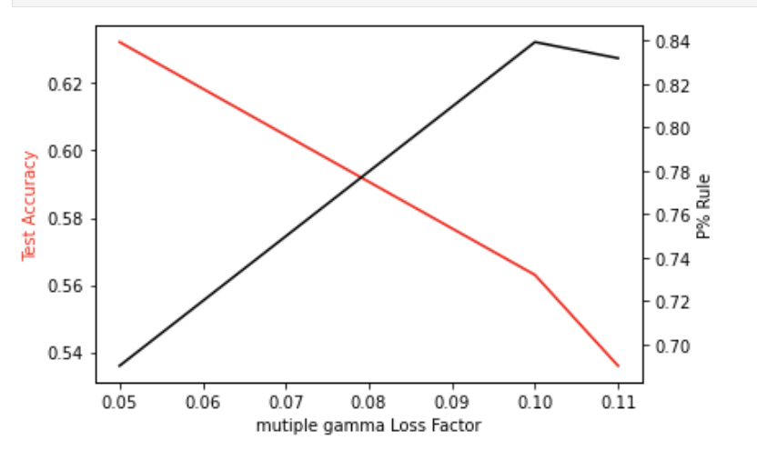
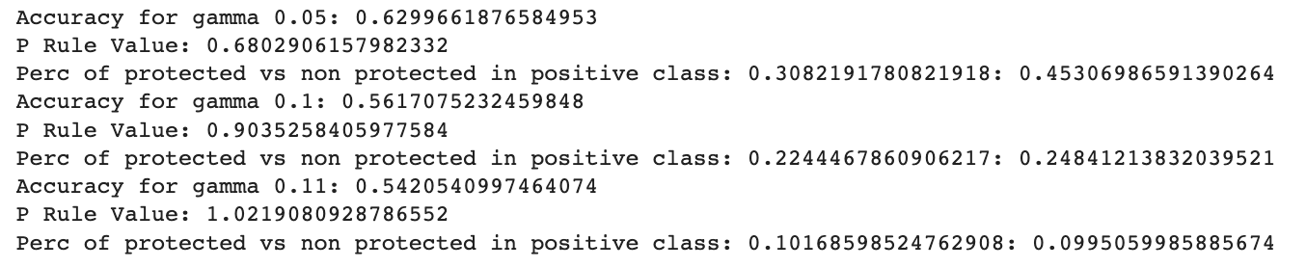
Model2: (A3)Maximizing Fairness Under Accuracy Constraints
Results:
1.Both the train accuracy and test accuracy is about 0.66
2. The p%-value of test accuracy is larger than that of train accuracy.

Slide 10
Conclusion
Compared with A1 and A3, we find that the accuracy for the LFR model is 80% and the accuracy of the Gamma/ Fine-Gamma model was 66%. A decrease in accuracy when implementing fair classification was expected, however, additional factors such as sampling bias could have affected the accuracy.
In comparison with logistical regression model with an accuracy of 66%, the gamma model was similar since it accounts for accuracy. However, the LFR models of the protected and unprotected groups were higher than the logistic regression of the data overall.

Slide 11
Reference
https://cs.stanford.edu/~sanmi/documents/Representation_Learning_Fairness_NeurIPS19_Tutorial.pdf
Fairness Constraints: Mechanisms for Fair Classification
Learning Fair Representations

